Slide 1



AI-based Generative QA System
Group No: 17
Team Members
Chandrasekhar B
K Kasi Viswanath

Slide 2

Objective:
Fine-tune a GPT variant model to generate succinct email subjects from email bodies.
Develop a QA system to generate answers to AIML-related questions.

Slide 3
Project Overview :
Email Subject Line Generation:
Fine-tune a GPT model using a prepared dataset.
Generate succinct email subjects from email bodies.
Additional Learning: Explore and compare other LLM models such as BERT, T5, BART, and etc. to understand their performance in email subject generation. Learn from different architectures to enhance the effectiveness of the GPT model.
Question Answering on AIML Queries:
Create a new dataset for AIML questions.
Fine-tune a GPT model to generate answers to these questions.
Additional Learning: Investigate other LLM models like T5, BERT, BART and etc. for question answering. Compare their results to gain insights into their strengths and weaknesses in handling AIML queries.

Slide 4
Email Subject Line Generation
The task is focused on generating concise email subject lines by summarizing key sentences from the email body, specifically targets email summarization.
Dataset: Annotated Enron Subject Line Corpus
Description:
Content: This dataset includes a subset of cleaned, filtered, and deduplicated emails from the Enron Email Corpus, featuring employee inboxes from the Enron Corporation.
Evaluation Split: The development and test sets each have 3 annotated subject lines per email by human annotators. This approach provides multiple reference points, as there isn't always one unique, appropriate subject line per email.
Statistics:
Train/Dev/Test Splits: 14,436 / 1,960 / 1,906
Average Email Length: 75 words
Average Subject Length: 4 words

Slide 5
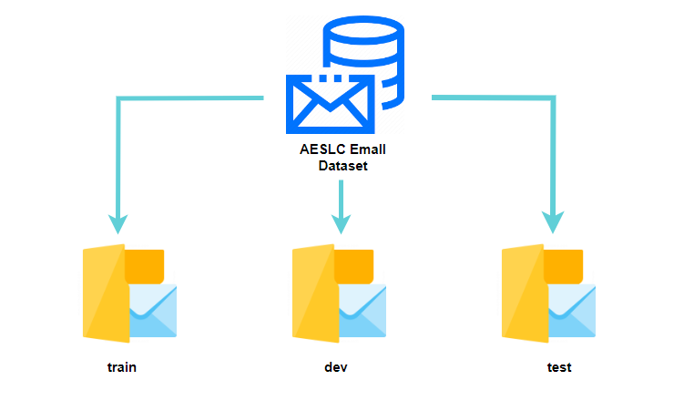
AESLC Email dataset info
14,436
1,960
1,906

Slide 6

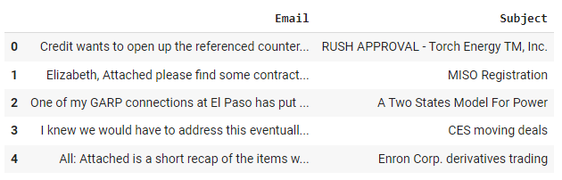
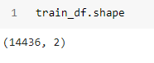
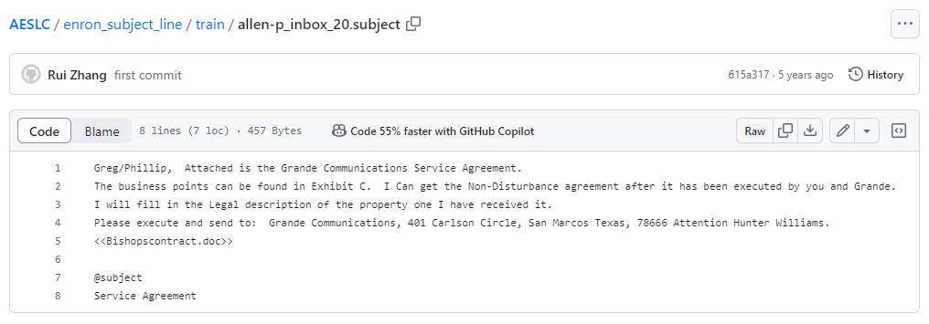
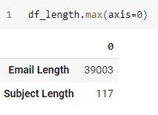
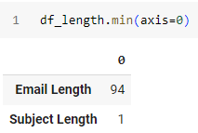
AESLC train dataset preprocess
train folder

Slide 7
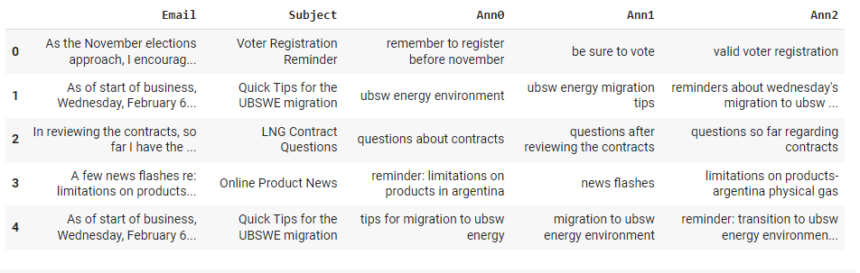
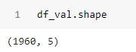
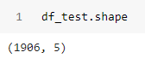
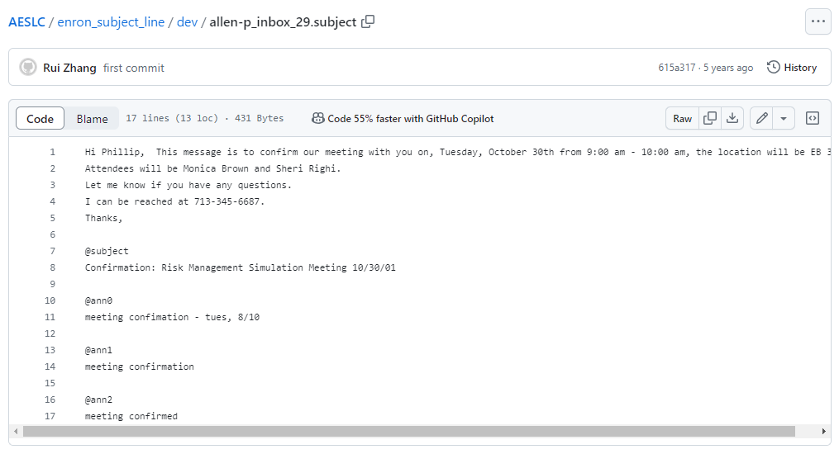
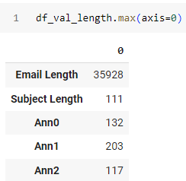
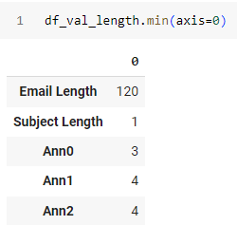
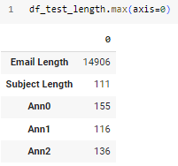
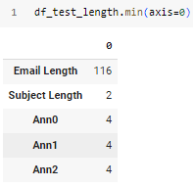
AESLC dev and test dataset preprocess

Slide 8
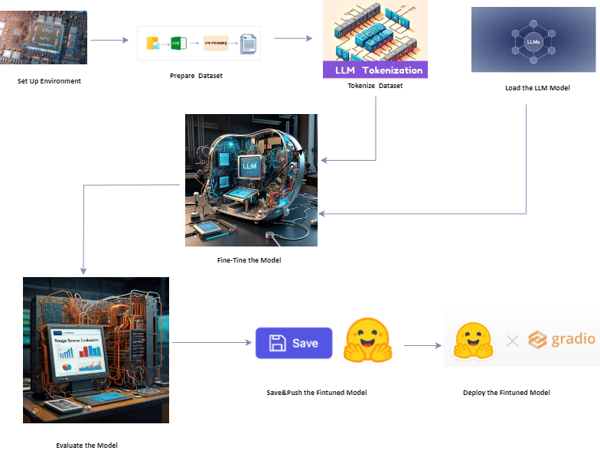
LLM Model Fine-Tune for Email dataset

Slide 9
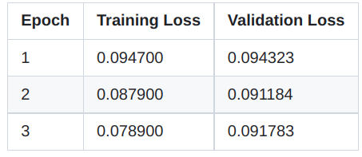
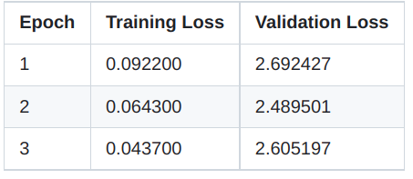
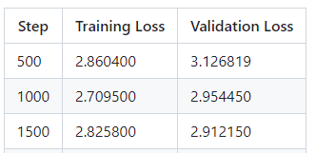
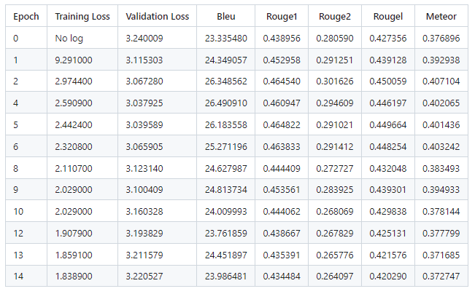
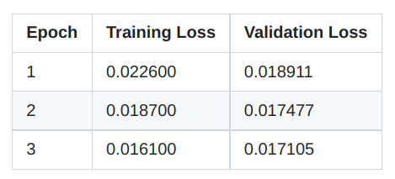
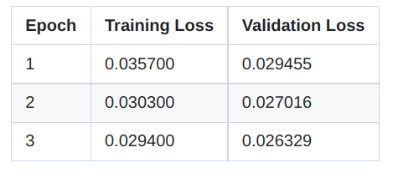
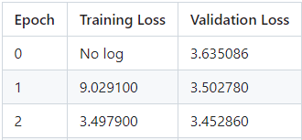
Training Results for Email Subject Line Generation
GP2
BART Base
BART Large-CNN
GPT2-Medium
T5 Base
T5 Small
distilgpt2

Slide 10
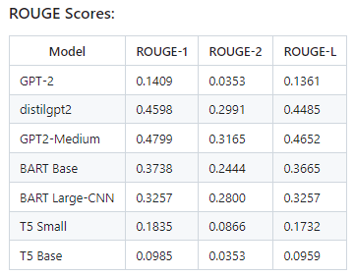
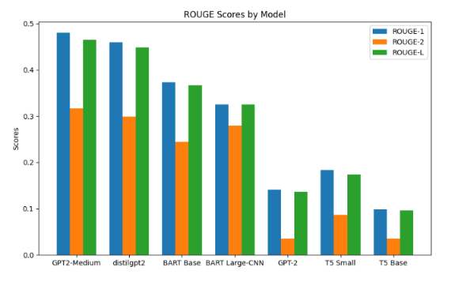
ROUGE Scores for Email Subject Line Generation

Slide 11
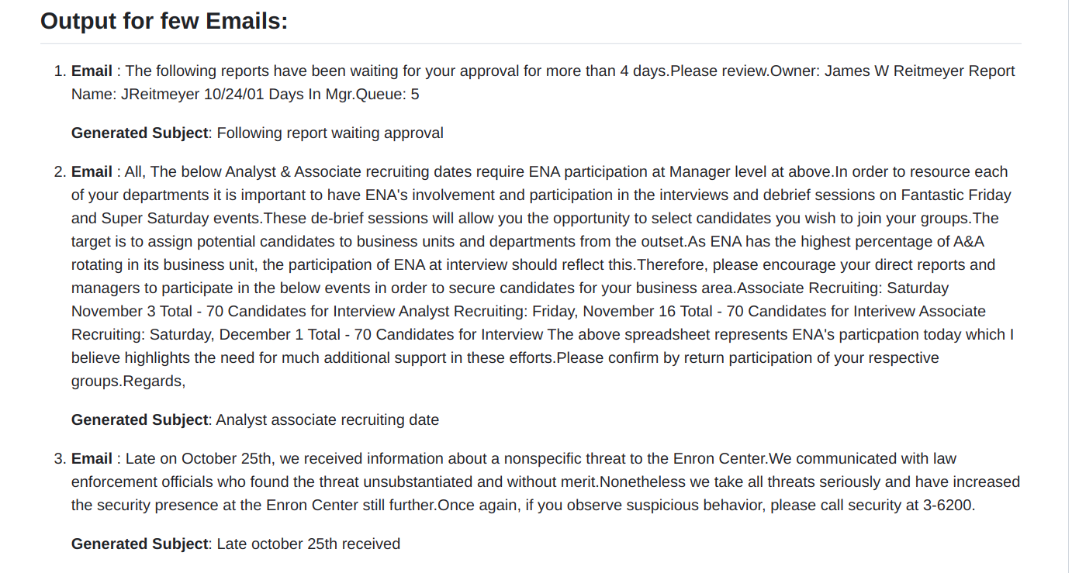
Sample Output Results for Email Subject Line Generation

Slide 12
Question Answering on AIML Queries
Building on the experience gained from the first task, this task focuses on developing a domain-specific GPT variant model to answer questions related to the AIML course. Pretrained models often perform well on general tasks but may struggle with domain-specific queries. To address this, the model needs to be fine-tuned on a dataset specifically tailored to AIML topics.
Key Aspects:
Domain-Specific Modeling: Fine-tune a GPT variant model to improve its ability to handle AIML-related questions.
Dataset Creation: Collaborate to build a relevant dataset specifically for AIML questions.
Performance Evaluation: Assess the model's effectiveness by testing it on new, unseen AIML queries.
This task provides an opportunity to refine model finetuning techniques, develop domain-specific datasets, and evaluate the model’s performance in answering specialized questions.

Slide 13
Question Answering on AIML Queries dataset info
Dataset: AIML QA Corpus
Description:
Creation: This dataset will be curated collaboratively by all teams participating in the AIML course's NLP projects.
Content: Each team will contribute by answering a question bank of 250 questions, providing short 1-2 line answers which will be compiled into a CSV file.
Source: Questions will be drawn from the AIML course material covered in lectures.
Deadline: The dataset needs to be completed within 1 month of the project start date to allow enough time for QA model fine-tuning.
Post-Creation: After dataset completion, a common train/dev/test split will be provided for further experimentation with the QA model.
These datasets are essential for fine-tuning and evaluating the models for their respective tasks, providing a solid foundation for the project.

Slide 14
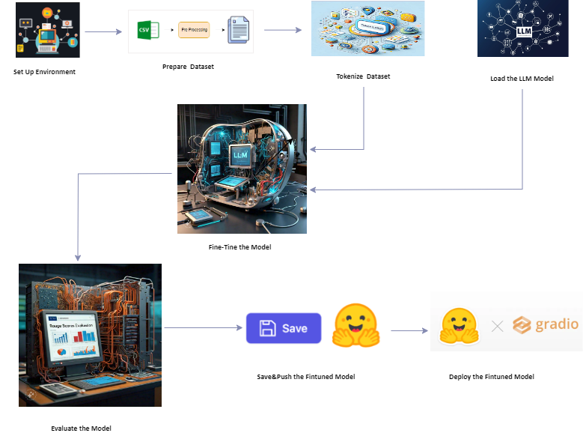
LLM Model Fine-Tune for Question Answering on AIML Queries

Slide 15
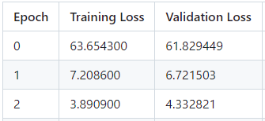
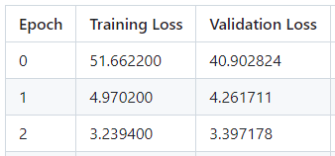
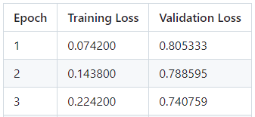
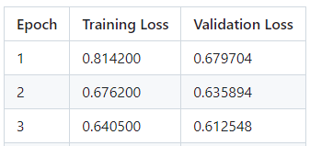
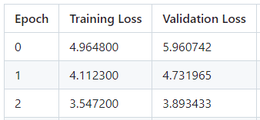
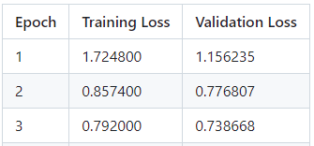
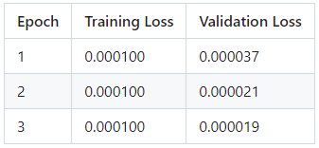
Training Results for Question Answering on AIML Queries
GP2
BART Base
BART Large-CNN
GPT2-Medium
T5 Base
flan-t5-base
distilgpt2
flan-t5-small
roberta-base

Slide 16
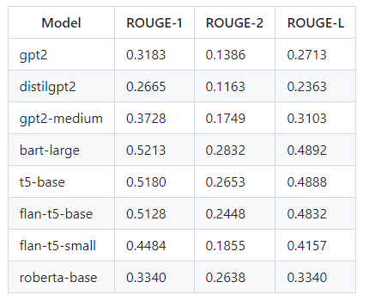
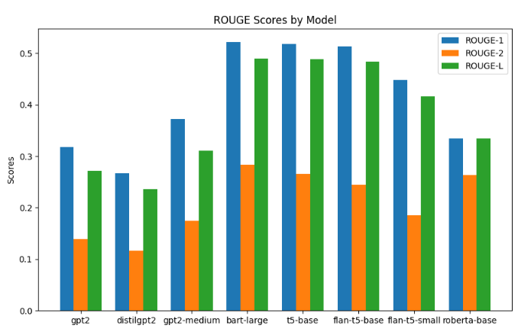
ROUGE Scores for Question Answering on AIML Queries

Slide 17
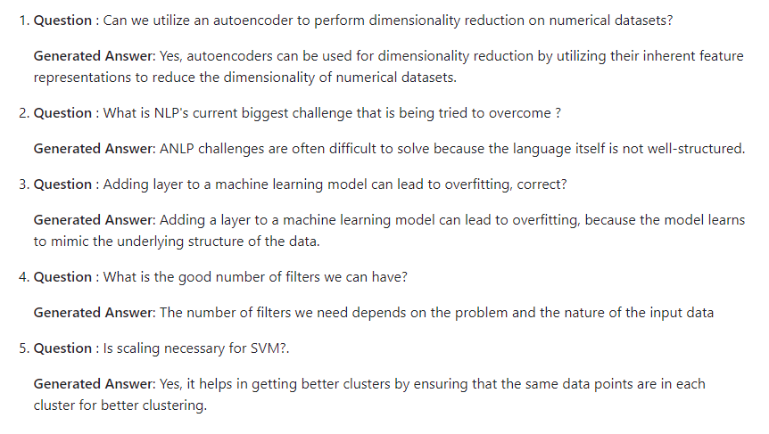
Sample Output Results Question Answering on AIML Queries:

Slide 18
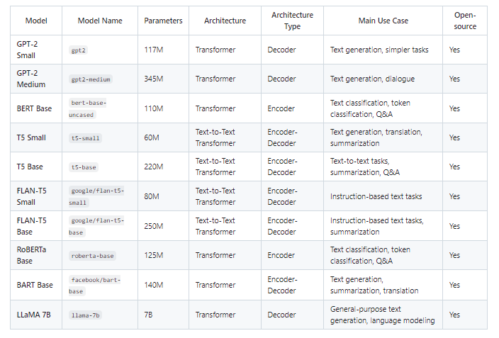
LLM Model Info

Slide 19
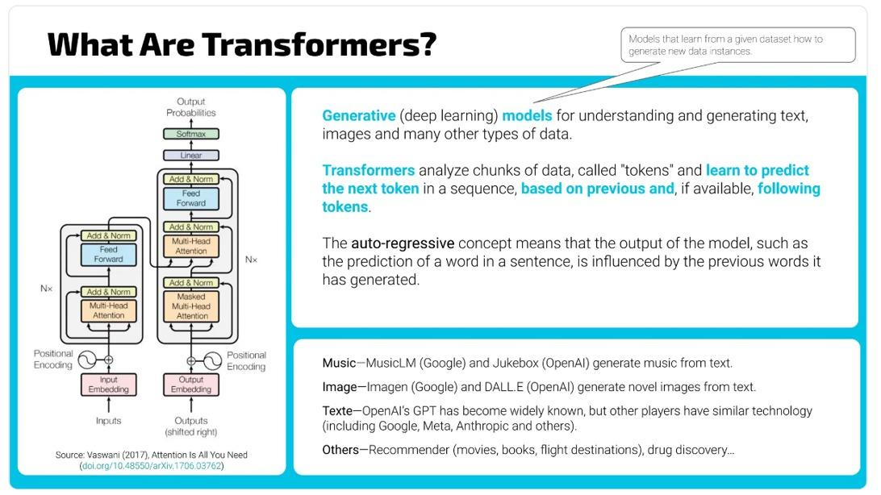

Slide 20
GPT-2 Model Training Process
Model Initialization & Data Handling:
Tokenizer and model initialized from GPT-2.
Training Arguments:
output_dir: Model checkpoints saved here.
num_train_epochs: 20, train batch size: 8, eval batch size: 16.
eval_steps: Every 400 steps, save_steps: Every 800 steps.
eval_strategy: 'epoch', metric_for_best_model: rougeL
gradient_accumulation_steps: 4, gradient_checkpointing: True, fp16: True.
save_total_limit: 1
Metrics Calculation & Trainer:
Computes ROUGE scores.
Handles training and evaluation, computes metrics
.

Slide 21
BART Model Training Process
Model Initialization & Data Handling:
BART-large model initialized from facebook/bart-large.
Training Arguments:
output_dir: Model checkpoints saved here, train/eval batch size: 8.
num_train_epochs: 20, eval_strategy: 'epoch', save_strategy: 'epoch'.
logging_steps: Every 10 steps.
eval_strategy: 'epoch', metric_for_best_model: rougeL
gradient_accumulation_steps: 4, gradient_checkpointing: True, fp16: True.
save_total_limit: 1
Trainer:
Calls trainer.train() to commence the fine-tuning process, logging training and validation losses..

Slide 22
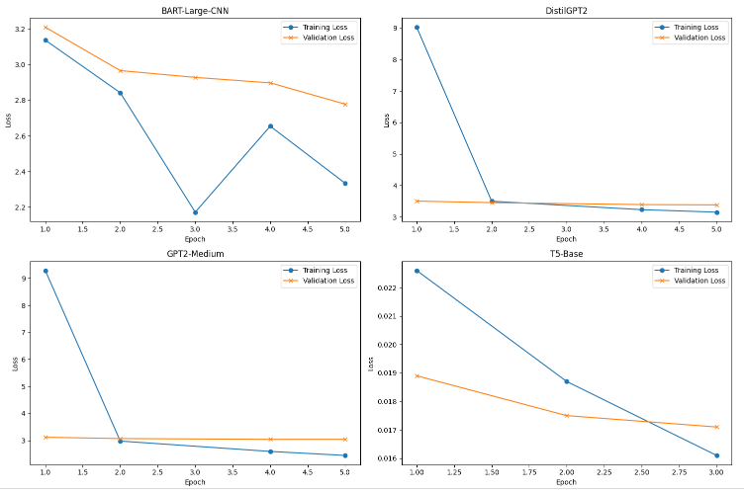
Training loss and Validation loss for Email Subject Line Generation

Slide 23
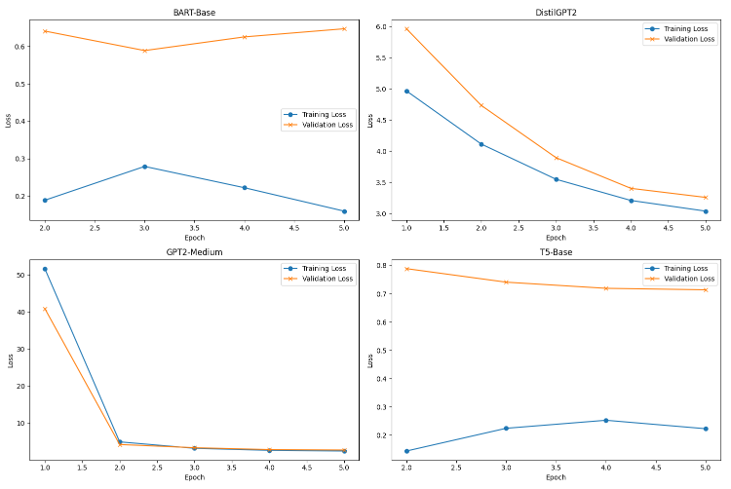
Training loss and Validation loss for Question Answering on AIML Queries

Slide 24
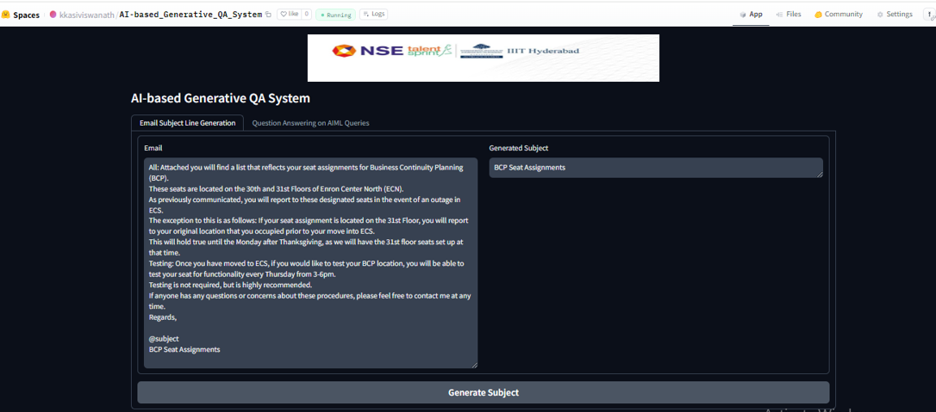
In .. Huggingface Spaces
The deployment of the project Email Subject Line Generation model and Question Answering on AIML Queries model using Hugging Face and Gradio can be found in the following directory:
Hugging Face Gradio project Deployment

Slide 25
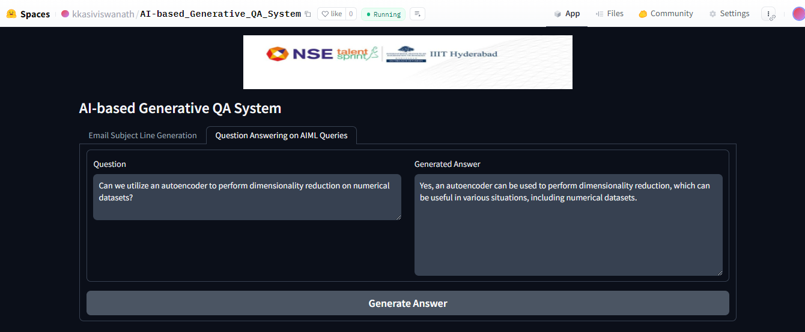
In .. Huggingface Spaces

Slide 26
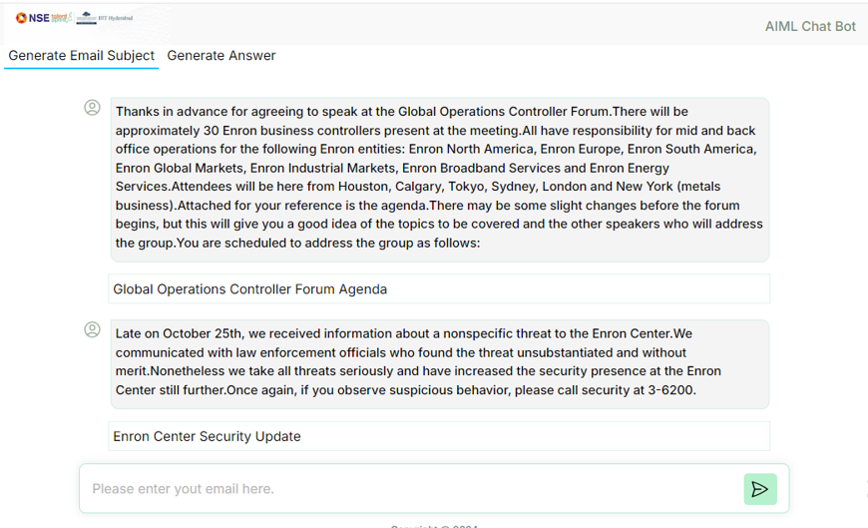
GUI for AI-based Generative QA System

Slide 27
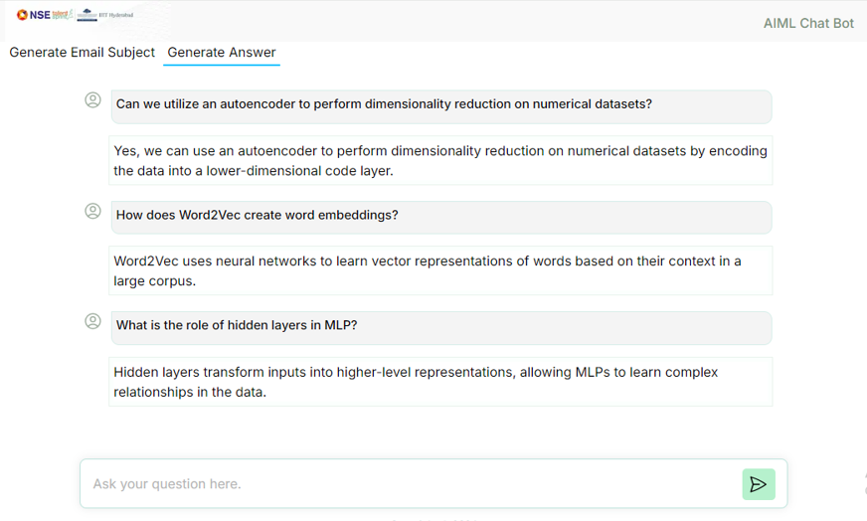
GUI for AI-based Generative QA System

Slide 28
LLM Model Fine-tuning Challenges
Tokenization Issues:
Identify and using correct tokenizer based on selected LLM model
LLM Model Loading and Fine-Tuning:
1. While Fine-tune LLM models require significant computational power (e.g., high-end GPUs).
2. Unable Fine-tune large models due to lack of GPU’s, it can be cost-prohibitive and time-consuming.
3. To find the right hyperparameters (e.g., learning rate, batch size)
Optimization and Evaluation
Test with various hyperparameters, architectures, and datasets based on selected LLM models.

Slide 29


